Slide 1
Kaya Uke
My project? Flexible, Biocompatible, and Wirelessly Powered Implantable Optoelectronics: Mechanical Simulations Design Optimisation | What I did last four weeks? Model Imported to COMSOL COMSOL Mechanical Simulations Writing Conference paper
Problem being faced? COMSOL protocol – Sim Setup Isotropic – Anisotropic Problem Formulation to Report | What to do in next two weeks? Simulation(COMSOL) Realtime 4 point Bend Analysis Writing the Thesis

Slide 2
The Work
Circuit
and
Antenna
Simulation
Encapsulation

Slide 3
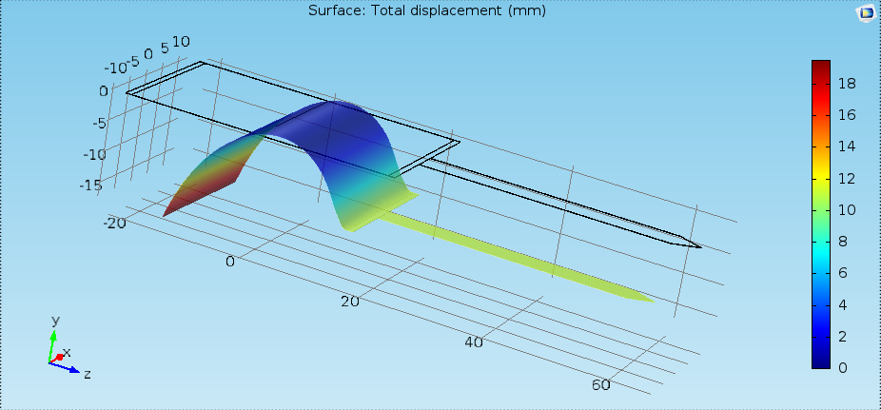
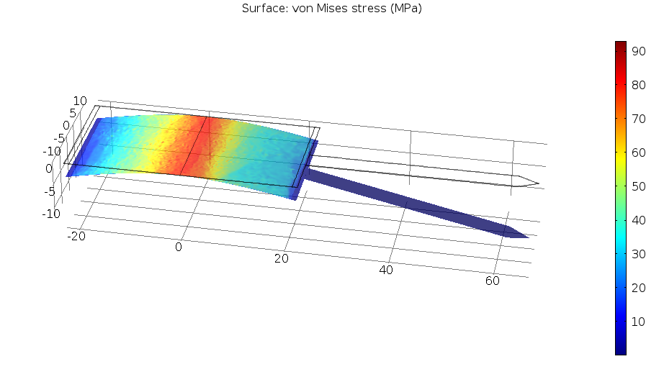
Evolution of Simulations
1st Setup:
Solidworks Import to COMSOL
2nd Setup: Mid Axis Bending

Slide 4
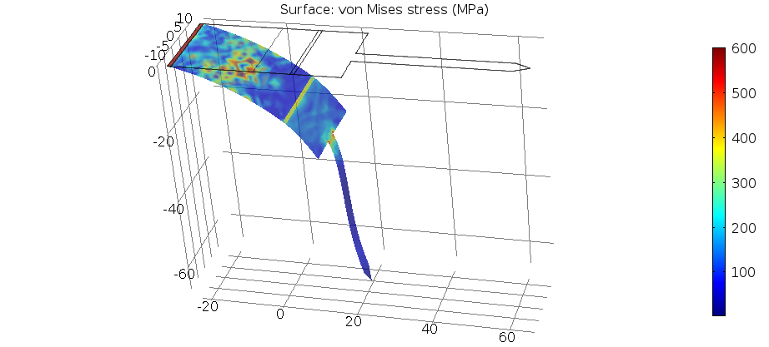
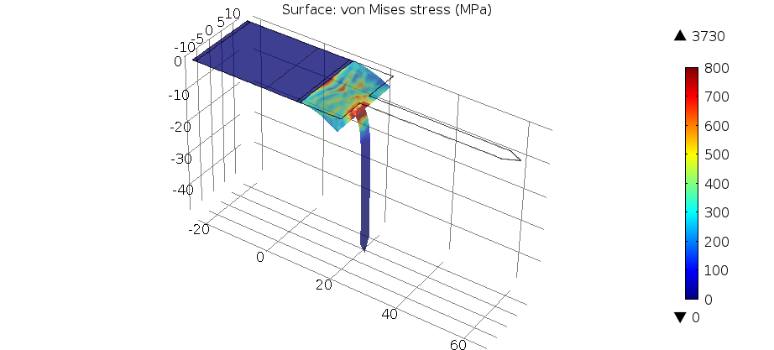
Evolution of Simulations
3rd Setup: Defined Boundaries
4th Setup: 90° Shank Bending: Implantation Case

Slide 5
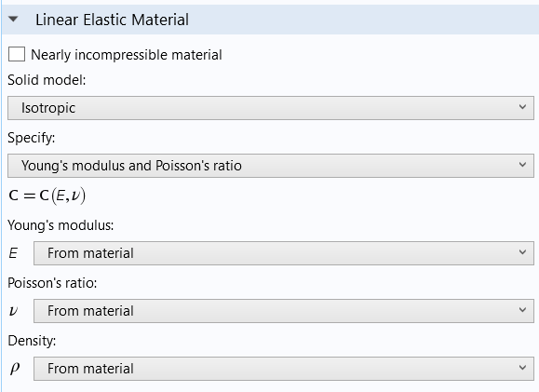
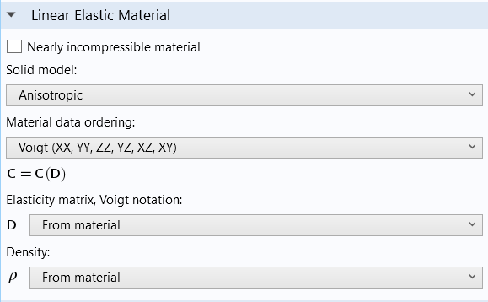
Problem: COMSOL
Reverse engineer/study Hadi’s model
Isotropic – Anisotropic
Simulation Setup = Changes everything

Slide 6
Problem Formulation
In Implantation Case:
Show Flexibility
Handle Stress
Average
Max
Build an Optimisation
Model for Stress

Slide 7
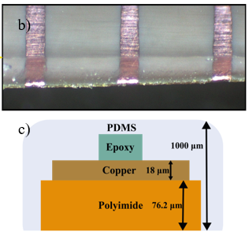
Paper: Research Flow
1st Step
Encapsulation Material Sweep
2nd Step
PDMS Thickness Optimisation
Range:
75 to 1000µm
3rd Step
Fabrication:
1000µm
Polyimide
Parylene-C
PDMS

Slide 8
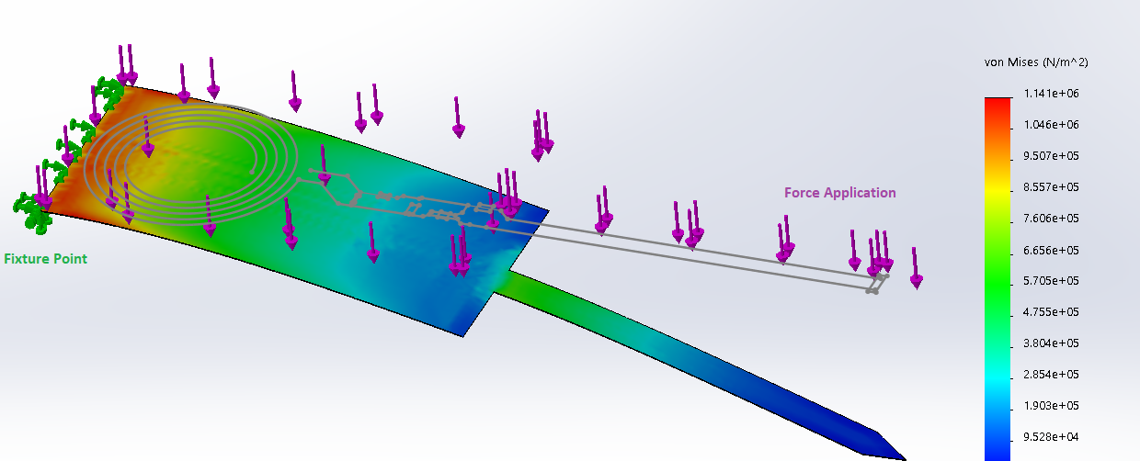
Future Work
Circuit Integration

Slide 9
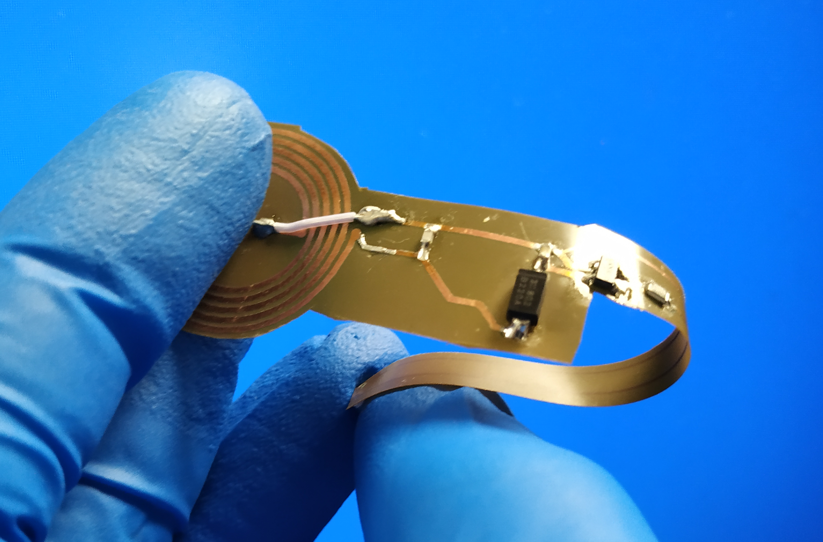
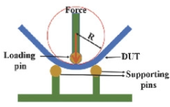
Future Work
Mechanical Test:
4 point Bending
COMSOL – Experimental Verification

Slide 10
Thanks for listening

